Slide 1
Resistors, GPIO and more
Week 07
Adrian Gould
Intermediate IoT
Cluster Title
ICTIOT502 | Program IoT devices
ICTIOT503 | Design and test IoT devices and networks
ICTPRG537 | Implement security for applications

Slide 2
Table of Contents
01
Power
02
Power use
03
Batteries
04
Calculating battery life
05
Conclusion

Slide 3
GPIO
ICTIOT503 Design and test IoT devices and networks

Slide 4
GPIO
General Purpose Input/Output

Slide 5
Pull Up and Pull Down Resistors
ICTIOT503 Design and test IoT devices and networks

Slide 6
Pull Up Resistor
Not a special type of resistor
When input signal is missing:
Ensure that a wire is pulled to a high logical level
Notes:
Pull-up and Pull-down Resistors | Resistor Applications | Resistor Guide (eepower.com)
https://eepower.com/resistor-guide/resistor-applications/pull-up-resistor-pull-down-resistor/#

Slide 7
Pull Down Resistor
Not a special type of resistor
When input signal is missing:
Ensure that a wire is pulled to a low logical level
Prevents an undefined/invalid signal
Notes:
Pull-up and Pull-down Resistors | Resistor Applications | Resistor Guide (eepower.com)
https://eepower.com/resistor-guide/resistor-applications/pull-up-resistor-pull-down-resistor/#

Slide 8
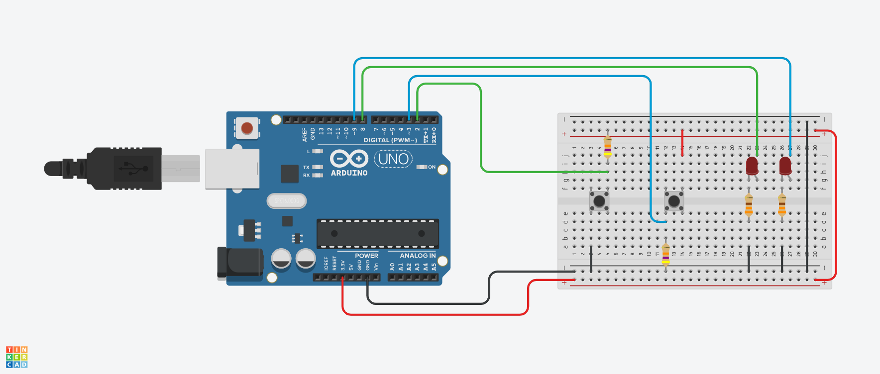
Pull Up Resistor
Pull Up
Pull Down
Notes:
Pull-up and Pull-down Resistors | Resistor Applications | Resistor Guide (eepower.com)
https://eepower.com/resistor-guide/resistor-applications/pull-up-resistor-pull-down-resistor/#

Slide 9

Quote:
As engineers, we were going to be in a position to change the world – not just study it.
Henry Petroski

